Slide 1
Exam Review Jeopardy
APS106

Slide 2
Rules of the GAME
Form a team with your table or tables around you (sizes ~2-4)
Choose a team name for the scoreboard
Go to https://www.multibuzz.app
Enter the Room Code TQCWMG and your Team Name
If you get the answer right, you gain the points, and pick the next category
If you get the answer wrong, you lose the points, and the next person who buzzed in is up
Ask questions if you’re confused! Remember, if you’re confused, so are others!

Slide 3
Panel
SpongeCode SquarePants
Scooby-Doocode
Codeball Z
The Simpsons.py
Code Rangers
$250
$250
$250
$250
$250
$500
$500
$500
$500
$500
$750
$750
$750
$750
$750
$1000
$1000
$1000
$1000
$1000
FINAL JEOPARDY

Slide 4

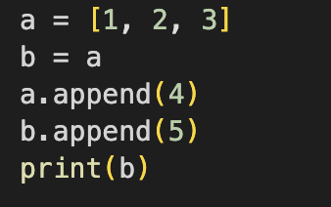
What is the result?
SpongeCode SquarePants · $250
Question board
Notes:
[1,2,3,4,5]

Slide 5
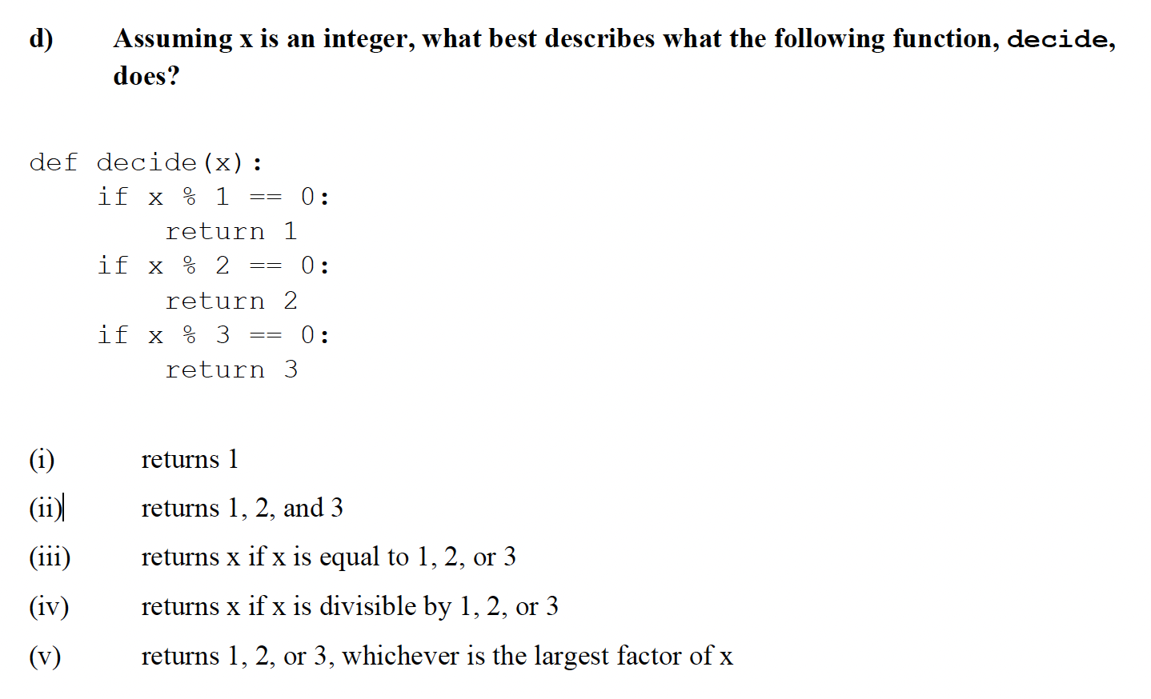
SpongeCode SquarePants · $500
Question board
Notes:
i – returns 1

Slide 6
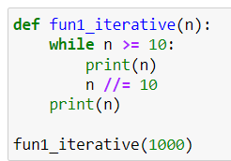
What is the output?
SpongeCode SquarePants · $750
Question board
Notes:
1000
100
10
1

Slide 7
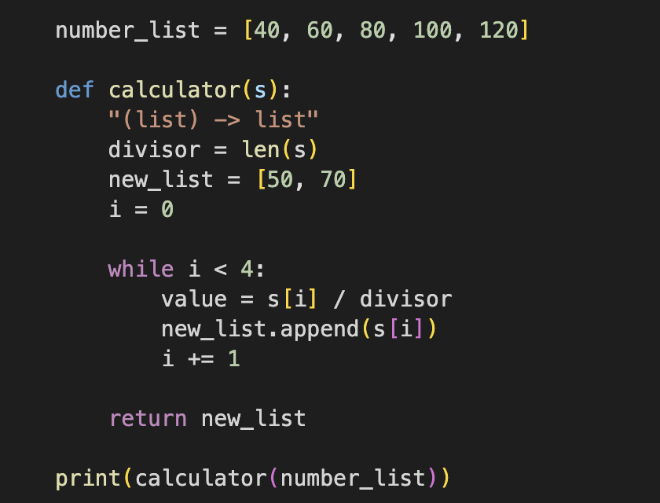
SpongeCode SquarePants · $1000
What is the output?
Question board
Notes:
[50, 70, 40, 60, 80, 100]

Slide 8
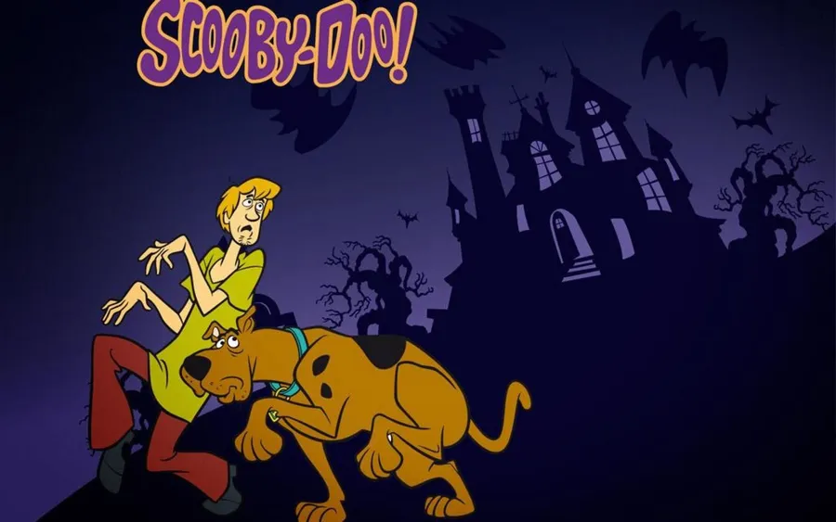
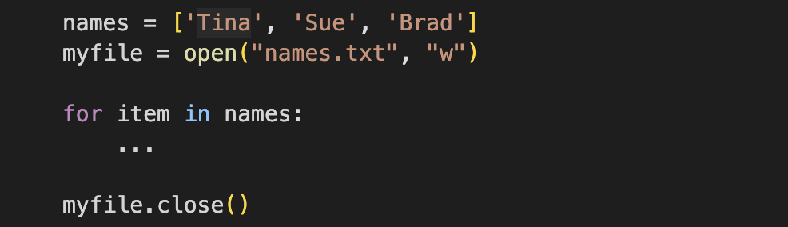
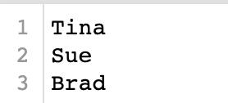
Scooby-Doocode · $250
What is the missing line of code to write the names into names.txt?
Question board
Notes:
myfile.write(item + ‘\n’)

Slide 9
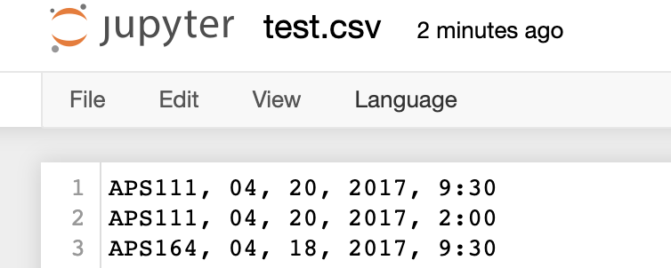
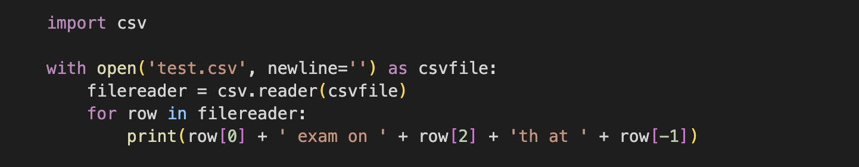
What is the output?
Scooby-Doocode · $ 500
Question board
Notes:
APS111 exam on 20th at 9:30
APS111 exam on 20th at 2:00
APS164 exam on 18th at 9:30

Slide 10
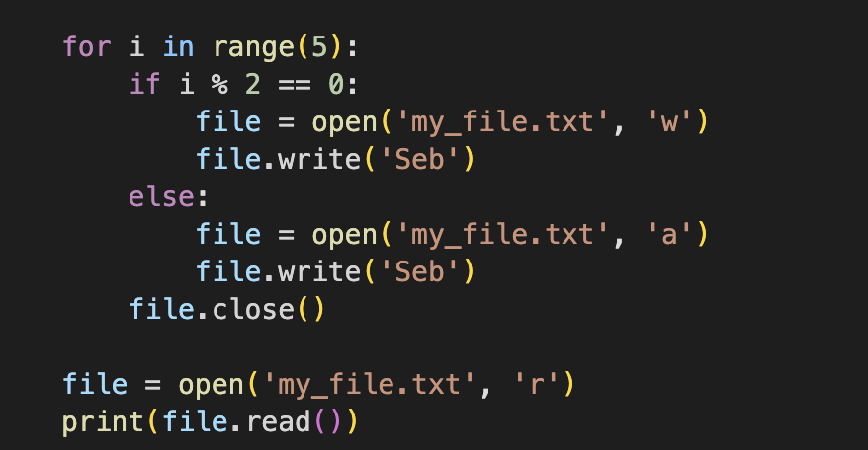
What is the output?
Scooby-Doocode · $750
Question board
Notes:
Seb

Slide 11
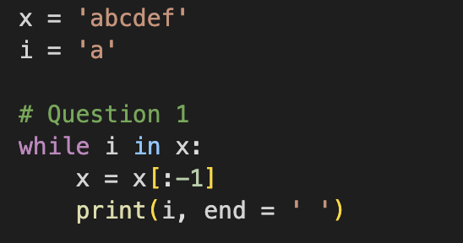
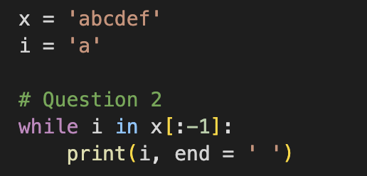
Is the output of the below codes same?
Scooby-Doocode · $1000
Question board
Notes:
Left: a a a a a a
Right: a a a a a a a a a a a a. (infinite loop)

Slide 12
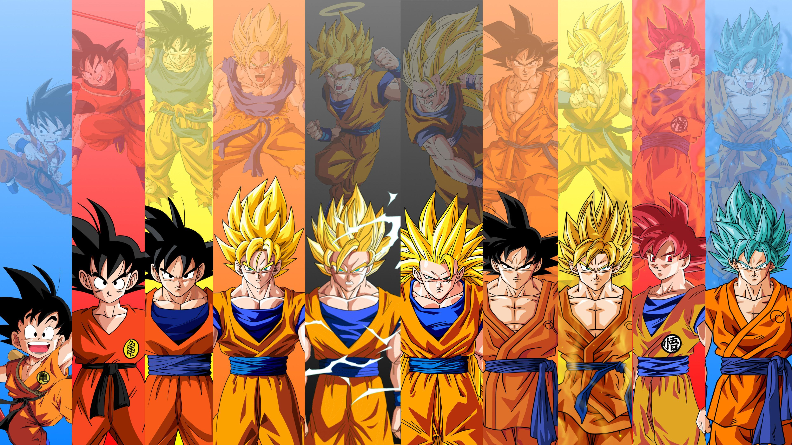
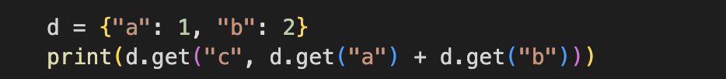
Codeball Z · $250
What is the output?
Question board
Notes:
3

Slide 13
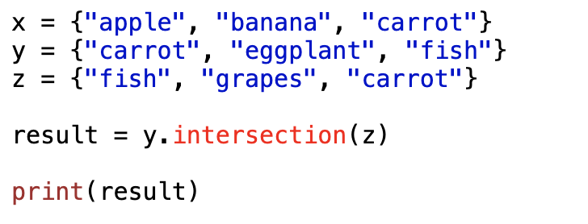
Codeball Z · $250
What is the output?
Question board
Notes:
{‘fish’, ‘carrot’}

Slide 14
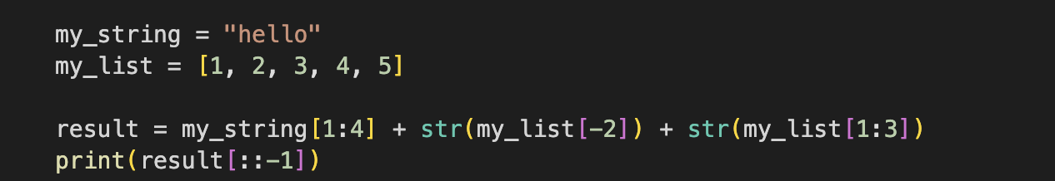
What will this code output?
Codeball Z · $500
Question board
Notes:
]3 ,2[4lle

Slide 15
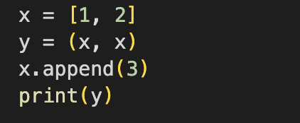
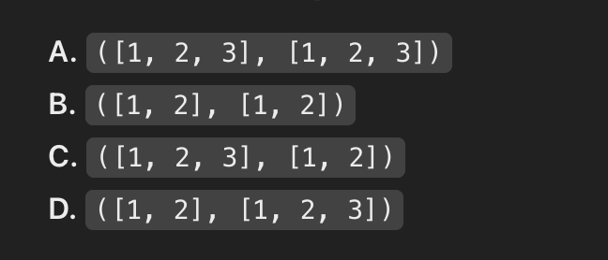
What will the code output?
Codeball Z · $750
Question board
Notes:
A ([1, 2, 3], [1, 2, 3])

Slide 16
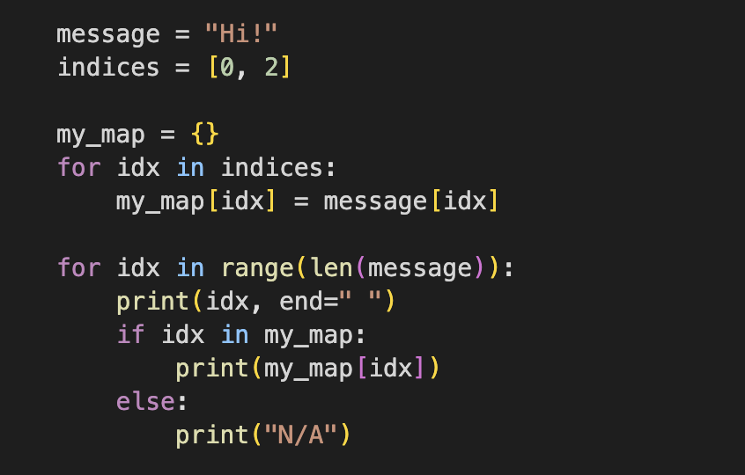
What is the output?
Codeball Z · $1000
Question board
Notes:
0 H
1 N/A
2 !

Slide 17
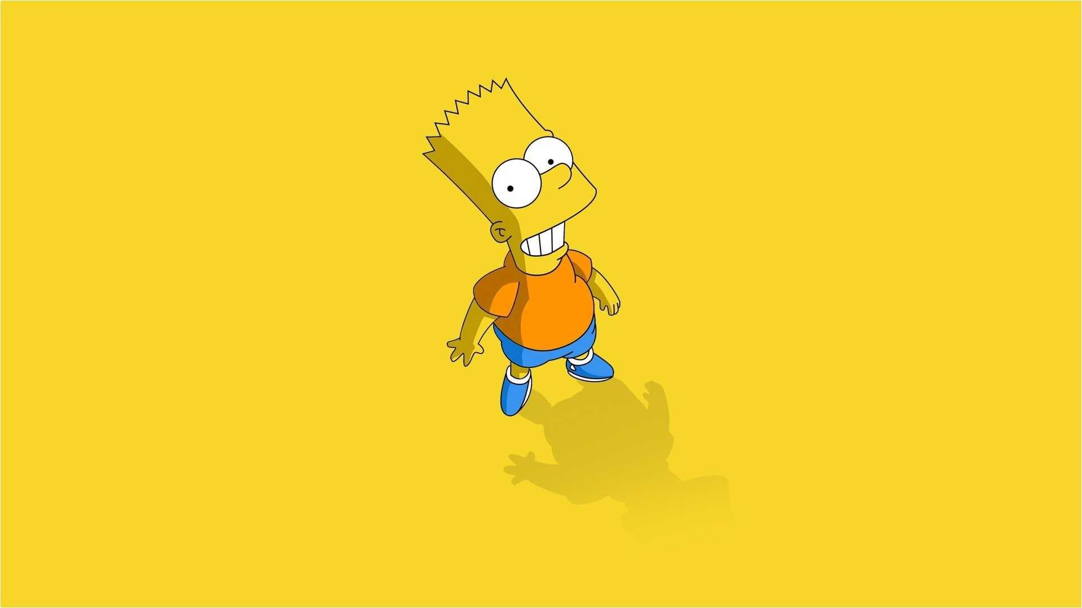
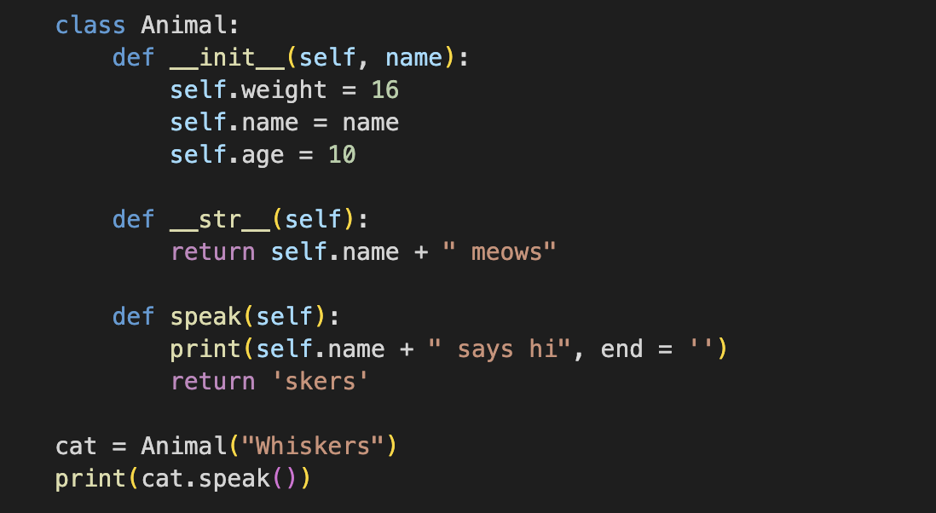
What is the output?
The Simpsons.py · $250
Question board
Notes:
Whiskers says hiskers

Slide 18
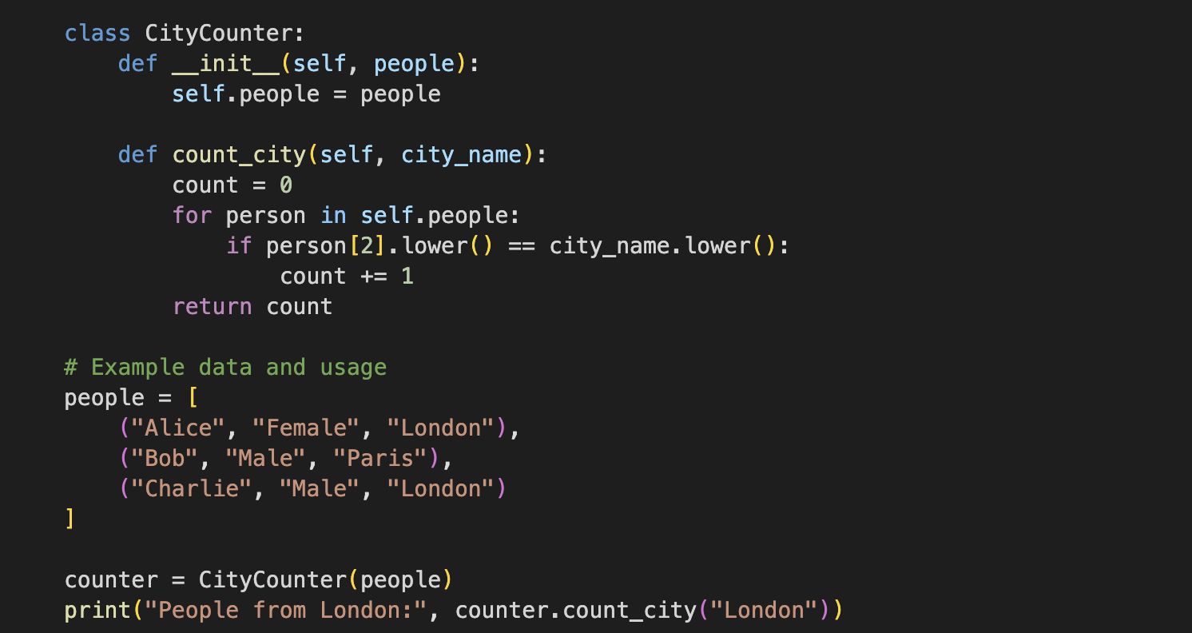
What is the output?
The Simpsons.py · $500
Question board
Notes:
People from London: 2

Slide 19
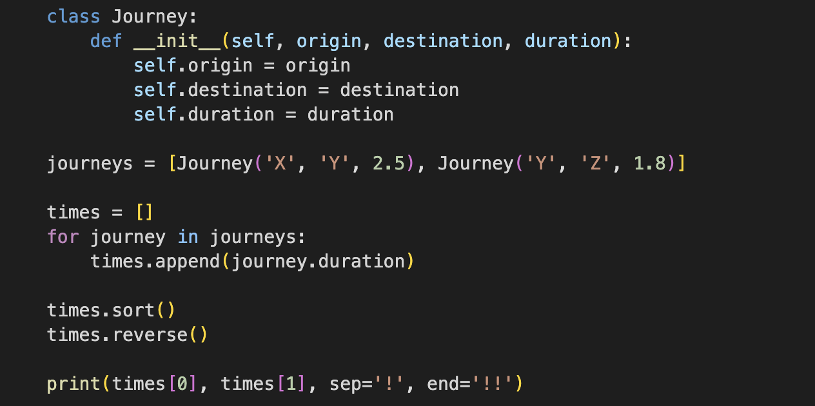
What is the output?
The Simpsons.py · $750
Question board
Notes:
2.5!1.8!!

Slide 20
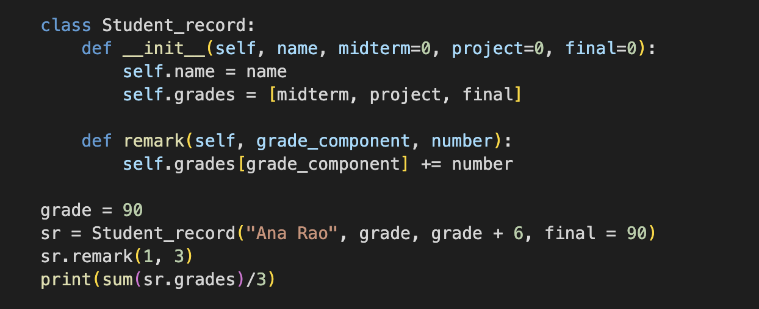
The Simpsons.py · $1000
What is the output?
Question board
Notes:
93.0

Slide 21
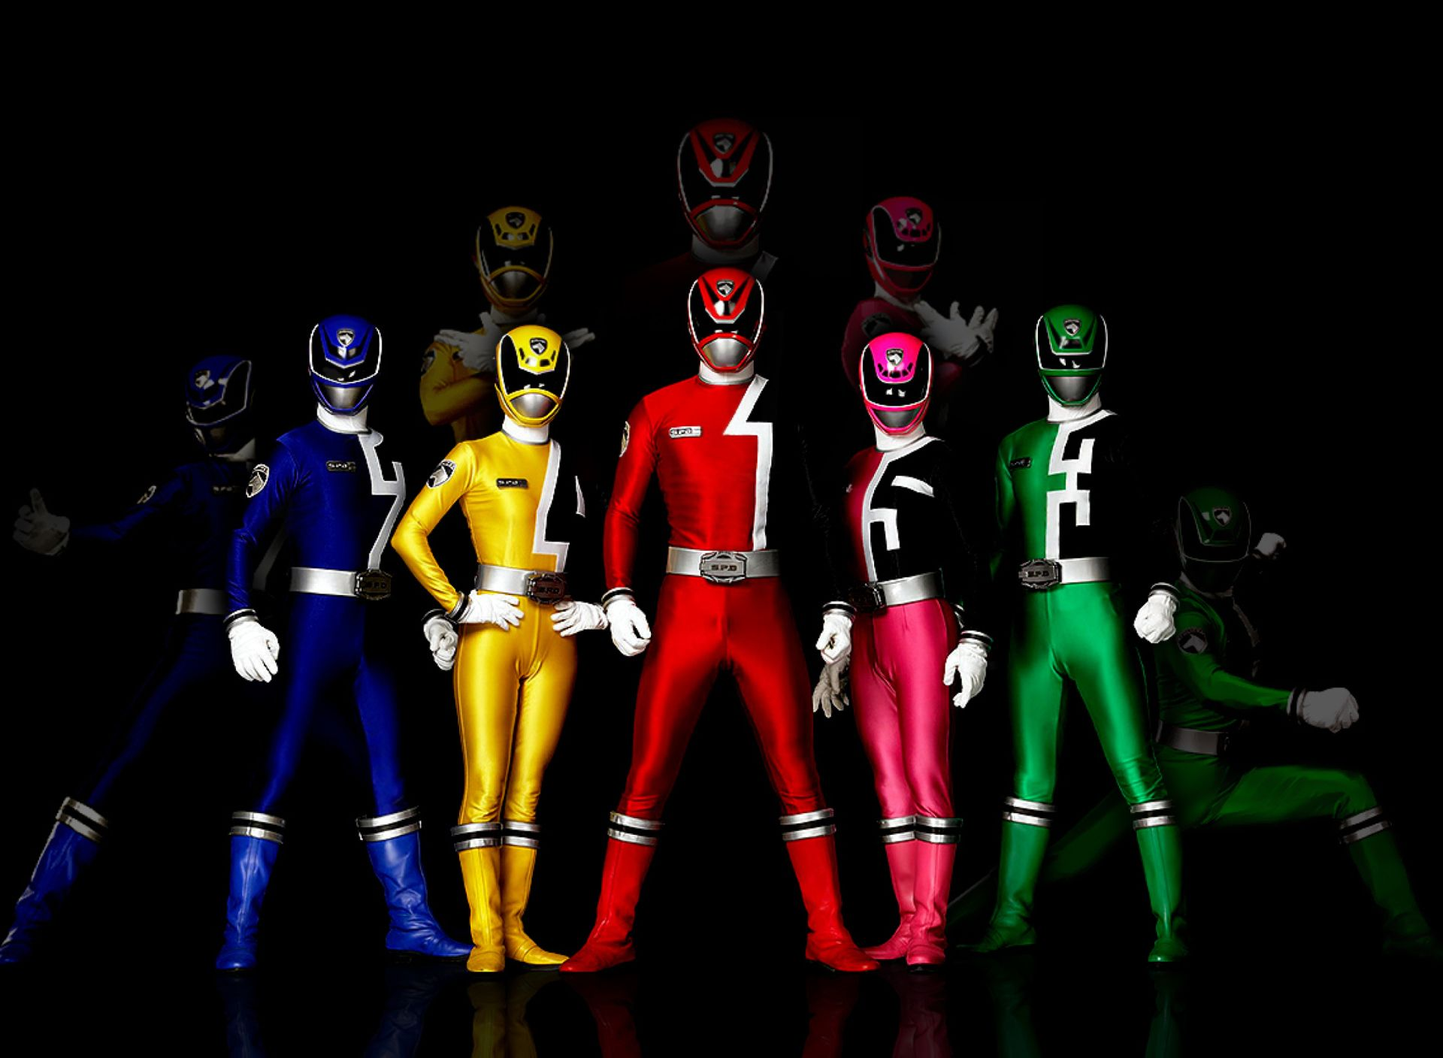
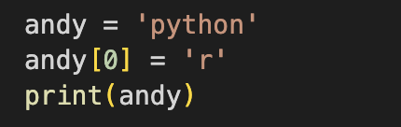
What is the output?
Code Rangers · $250
Question board
Notes:
Error str object does not support item assignment

Slide 22
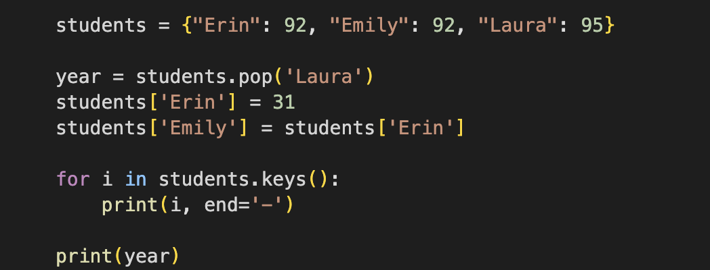
What is the output?
Code Rangers · $500
Question board
Notes:
Erin-Emily-95

Slide 23
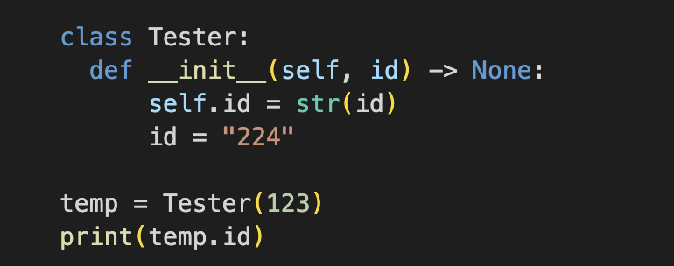
What is the output?
Code Rangers · $750
Question board
Notes:
123

Slide 24
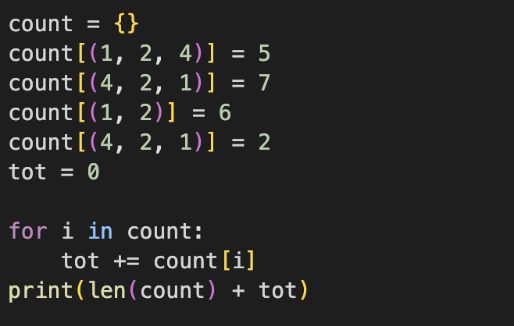
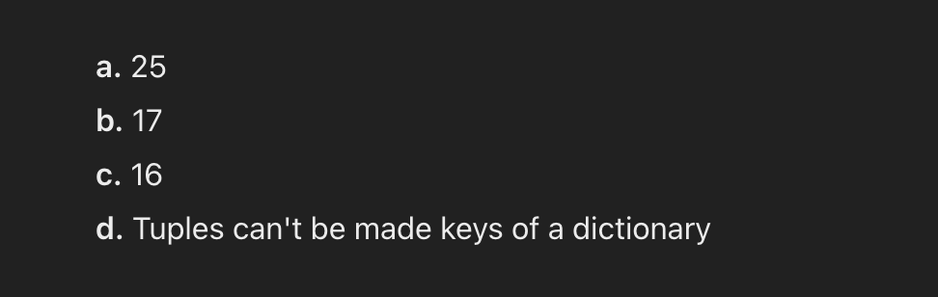
What is the output?
Code Rangers · $1000
Question board
Notes:
d

Slide 25
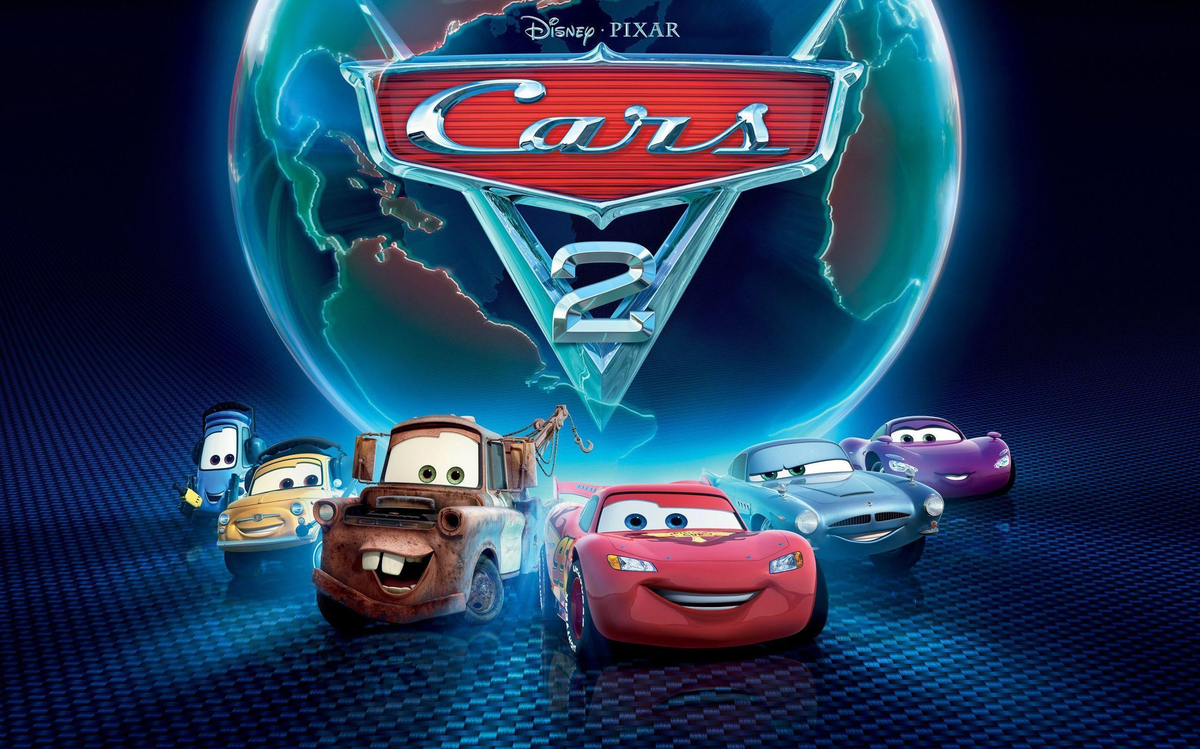
Final Jeopardy

Slide 26
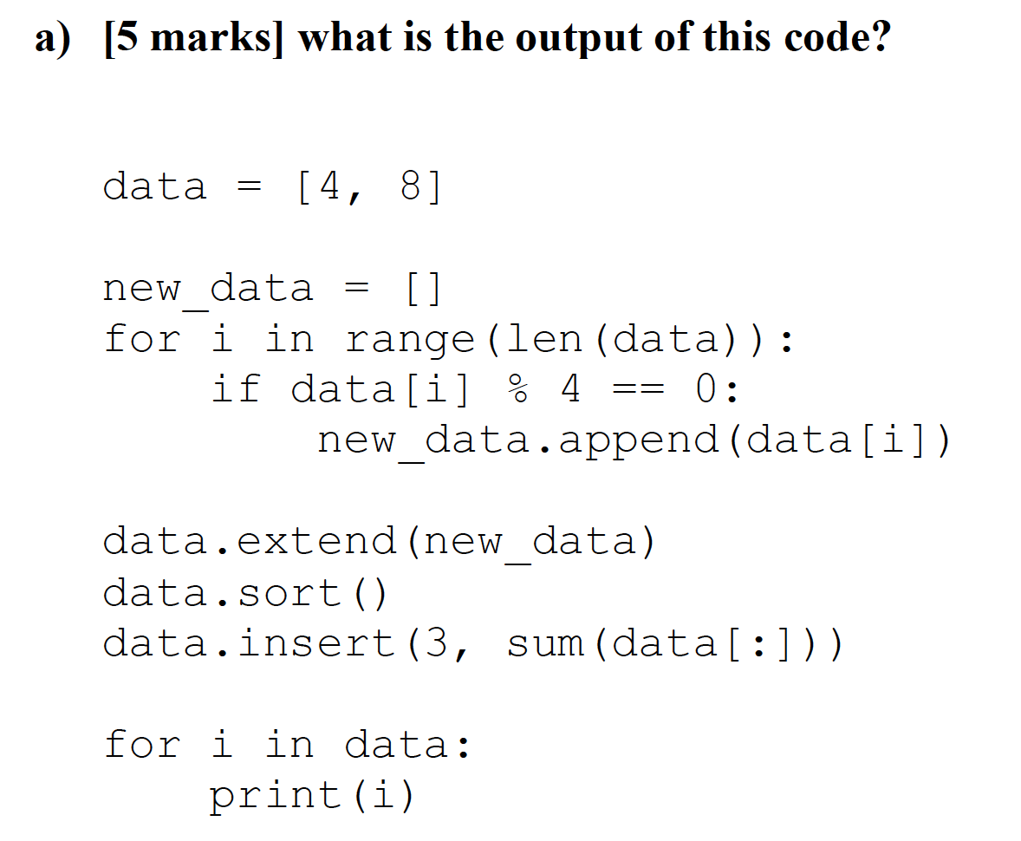
Question 1 · FINAL JEOPARDY
Notes:
4
4
8
24
8

Slide 27
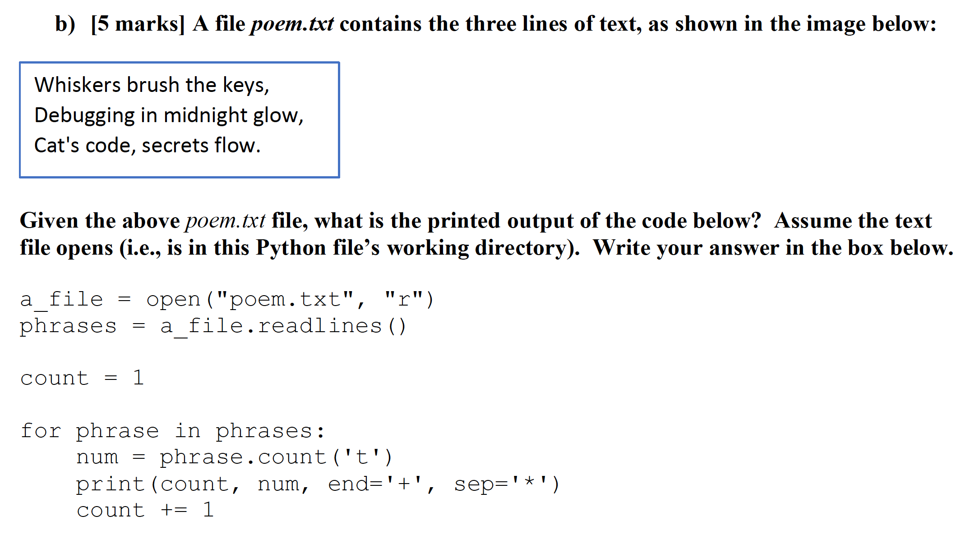
Question 2 · FINAL JEOPARDY
Notes:
1*1+2*1+3*2+

Slide 28
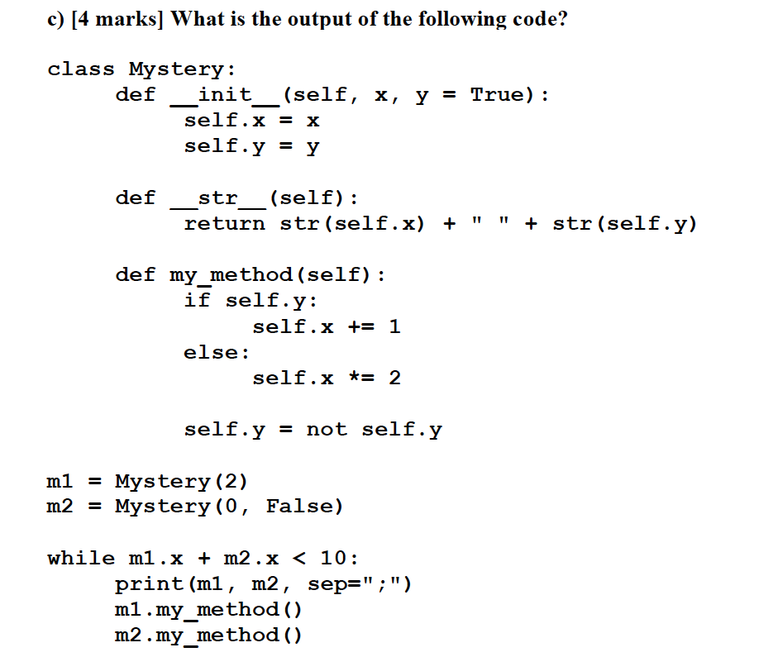
Question 3 · FINAL JEOPARDY
Notes:
2 True; 0 False
3 False; 0 True
6 True; 1 False
7 False; 2 True

Slide 29
